Slide 1
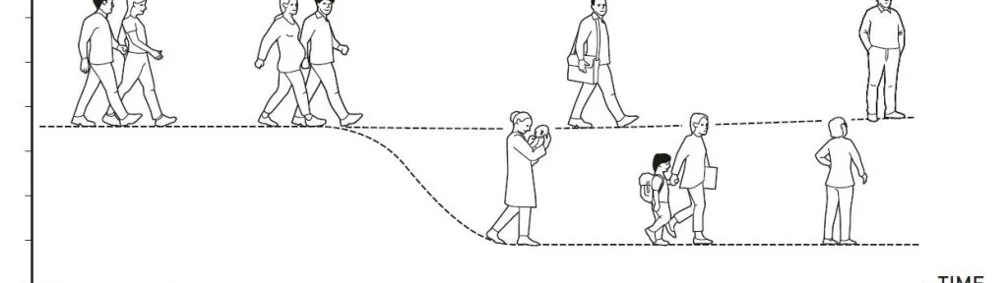
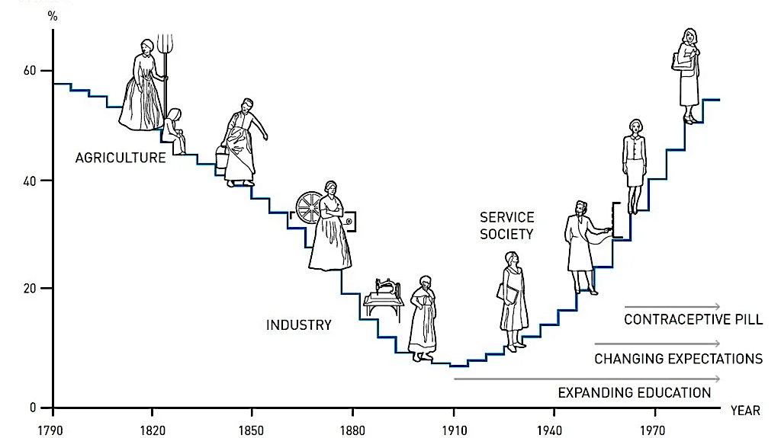
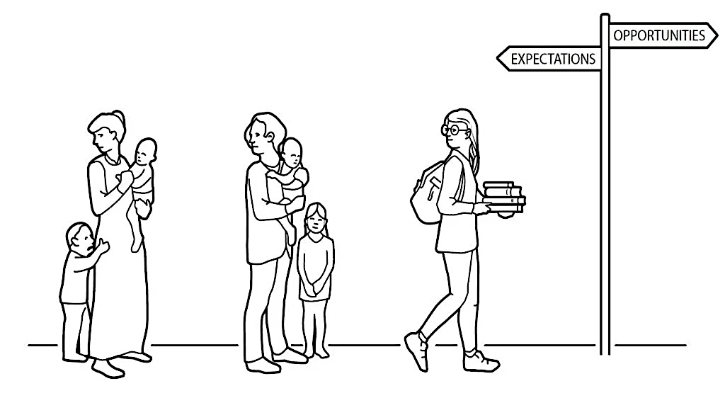
An Evolving Economic Force
© Johan Jarnestad/The Royal Swedish Academy of Sciences

Slide 2
Employment to Population Ratios for Women 25-54 Years
Are High Almost Everywhere in 2022

Slide 3
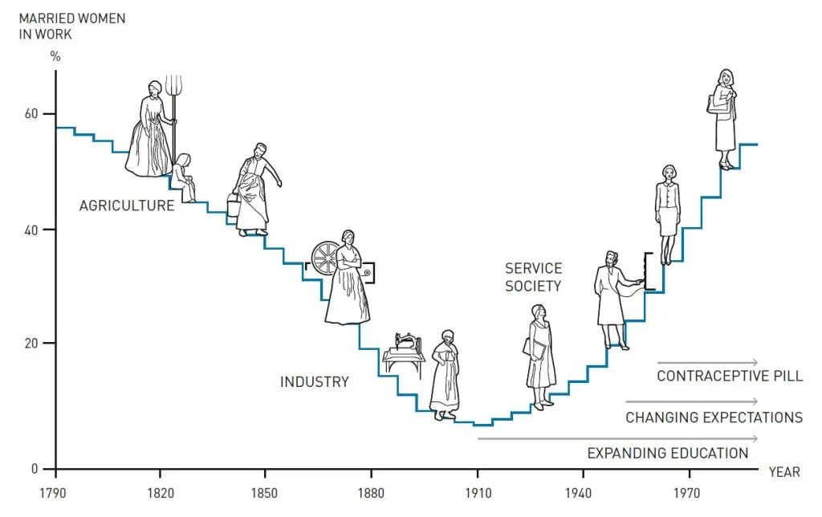



Slide 4
Employment to Population Ratios for Women 25-54 Years and GDP/capita in 2022

Slide 5

E/Pop for Women 25-54 Years and GDP/capita in 2022 is U-Shaped

Slide 6
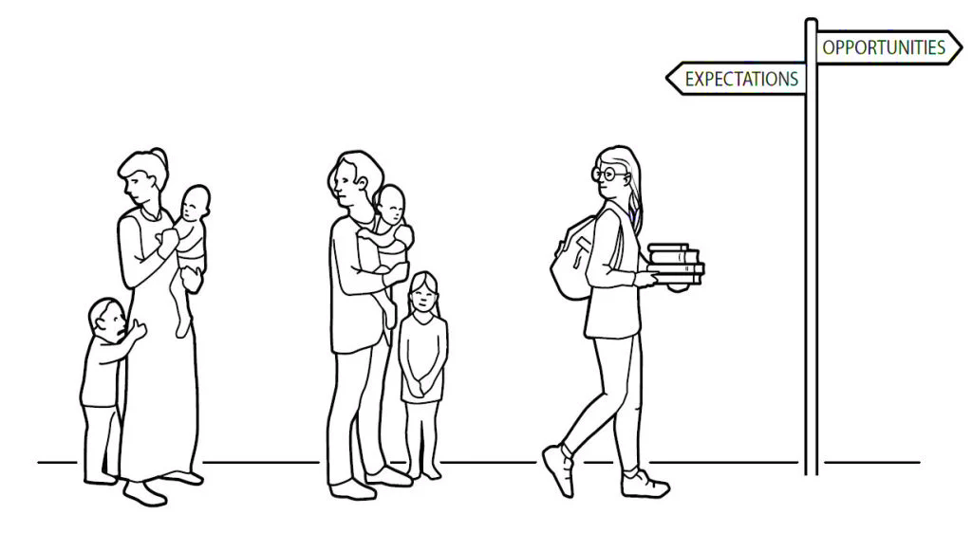
Female Labor Force Participation Rate: By Race, 35-44 years
Year

Slide 7

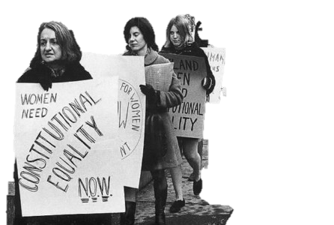
Noisy Revolution of 50 Years Ago
Photo source:
Nat’l Women's History Museum

Slide 8
College (4-Yr) Graduation Rates:
By 1982 More Females than Males Were Graduating College
Females (native born)
Males (native born)
Birth Year + 22 years
Notes:
And what about college (4-year) graduation rates? This is for all native-born in the US by sex.

Slide 9
More Women than Men
More Women than Men, 25-34 years, had attended college in all OECD nations in 2022
% Females 25-34 with some college, 2022
% Males 25-34 with some college, 2022

Slide 10
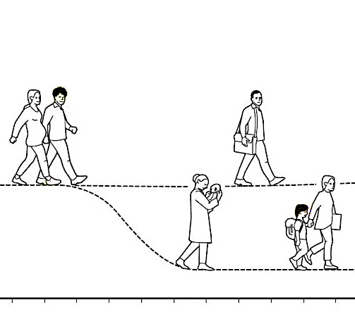
Fertility is Negatively Related to Gender Disparities in HH & Care Work
Total Fertility Rate
Hours per Day
the average woman does unpaid household and care work
more than does the average male

Slide 11
Median Age at First Marriage Soared for College Graduate Women Born in 1950s

Slide 12
Fraction Female among US Professional School Graduates Soared 1970s, 1980s
Medical
Law
Dental
MBA
Year

Slide 13
College Graduate Women’s Occupations Greatly Changed in the 1970s, 1980s
Year

Slide 14
Relative Earnings of Women Greatly Increased after 1980
All Workers
Year

Slide 15

Relative Earnings of Women Greatly Increased after 1980
83¢
75¢
65¢
59¢
Year

Slide 16

Relative Earnings of Women Greatly Increased after 1980
Less So for College Graduate Women
All Workers
College Graduate Workers
First Clue
Year
Credit for magnifying glass: Anzela Ksenofontova

Slide 17
Relative Earnings of College Graduate Women Begin High
But Decrease with Age for Each Birth Cohort
born c. 1978
c. 1973
Another Clue
c. 1968
c. 1958
c. 1963
Corrected for hours and weeks worked and education beyond college.
Credit for magnifying glass: Anzela Ksenofontova

Slide 18
Full-time, Full-year with Time and Education Controls, 2009-2011 ACS
Male Wage and Business Annual Income, log scale
60K 66K 73K 81K 89K 99K 109K 120K 133K 147K 163K 180K
= 0.82
Coefficient on Female × Occupation
= 0.74
Controls and sample: age as a quartic, race, ln(hours), ln(weeks), education, ACS years; none with < 25 individuals either male or female; 35+ hours, 40 + weeks; 25- to 64-year-olds.

Slide 19
Full-time, Full-year with Time and Education Controls, 2009-2011 ACS
Male Wage and Business Annual Income, log scale
60K 66K 73K 81K 89K 99K 109K 120K 133K 147K 163K 180K
Coefficient on Female × Occupation
Controls and sample: age as a quartic, race, ln(hours), ln(weeks), education, ACS years; none with < 25 individuals either male or female; 35+ hours, 40 + weeks; 25- to 64-year-olds.

Slide 20

Full-time, Full-year with Time and Education Controls, 2009-2011 ACS
Male Wage and Business Annual Income, log scale
60K 66K 73K 81K 89K 99K 109K 120K 133K 147K 163K 180K
Coefficient on Female × Occupation
Controls and sample: age as a quartic, race, ln(hours), ln(weeks), education, ACS years; none with < 25 individuals either male or female; 35+ hours, 40 + weeks; 25- to 64-year-olds.

Slide 21
Full-time, Full-year with Time and Education Controls, 2009-2011 ACS
Male Wage and Business Annual Income, log scale
60K 66K 73K 81K 89K 99K 109K 120K 133K 147K 163K 180K
Coefficient on Female × Occupation
Controls and sample: age as a quartic, race, ln(hours), ln(weeks), education, ACS years; none with < 25 individuals either male or female; 35+ hours, 40 + weeks; 25- to 64-year-olds.

Slide 22
Full-time, Full-year with Time and Education Controls, 2009-2011 ACS
(Male Wage and Business Income), log scale
60K 66K 73K 81K 89K 99K 109K 120K 133K 147K 163K 180K
Coefficient on Female × Occupation
More Clues
Controls and sample: age as a quartic, race, ln(hours), ln(weeks), education, ACS years; none with < 25 individuals either male or female; 35+ hours, 40 + weeks; 25- to 64-year-olds. Credit for magnifying glass: Anzela Ksenofontova

Slide 23
The Gender Pay Gap by Occupation is Related to O*NET Characteristics
Controls and sample: Gender pay gap for FT-FY workers, 25- to 64-year-old college graduates using ACS 2009-2011.

Slide 24
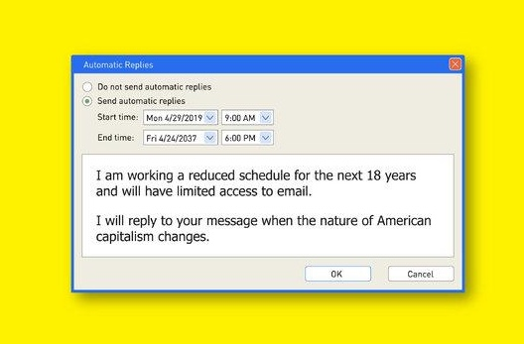
Women Did Everything Right and then Work Got Greedy
How America’s obsession with long hours has widened the gender gap
©

Slide 25
Gender Inequality Couple Inequity
Earnings
Less flexible job
●
More flexible job
●
Hours
H

Slide 26
Gender Inequality Couple Inequity
Earnings
Less flexible job
●
More flexible job
●
Hours
H

Slide 27


Gender
Inequality
Couple
Inequity
When couples gives up couple equity, they increase gender inequality.

Slide 28
Gender
Equality
Couple
Equity
When couples gives up couple equity, they increase gender inequality.

Slide 29


Mincer
Becker
Boserup
Easterlin
© Johan Jarnestad/Royal Swedish Academy of Sciences
“… for having advanced our understanding of women’s labor market outcomes.”
Credit for magnifying glass: Anzela Ksenofontova

Slide 30
Bertrand,
Blau, Kuziemko
Kerr, Mitchell
Polachek, Rouse Olivetti, Rotella
And especially
Larry Katz
© Johan Jarnestad/Royal Swedish Academy of Sciences
“… for having advanced our understanding of women’s labor market outcomes.”

Slide 31

© Johan Jarnestad/Royal Swedish Academy of Sciences
“… for having advanced our understanding of women’s labor market outcomes.”

Slide 32
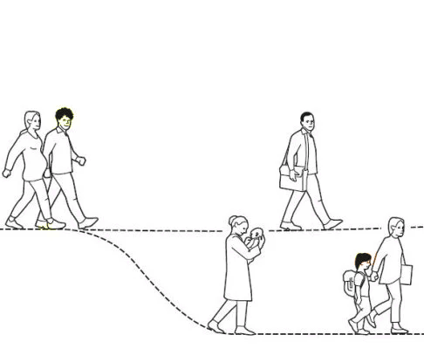
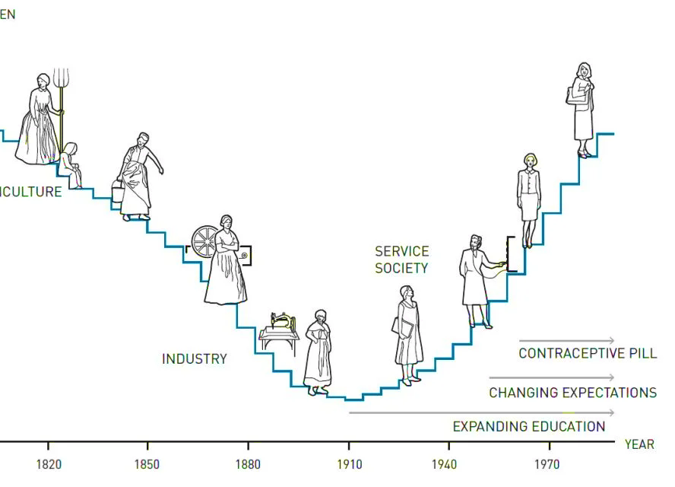
An Evolving Economic Force
Claudia Goldin
© Johan Jarnestad/The Royal Swedish Academy of Sciences

